Slide 1
Welcome to Otis
www.otis.com

Slide 2
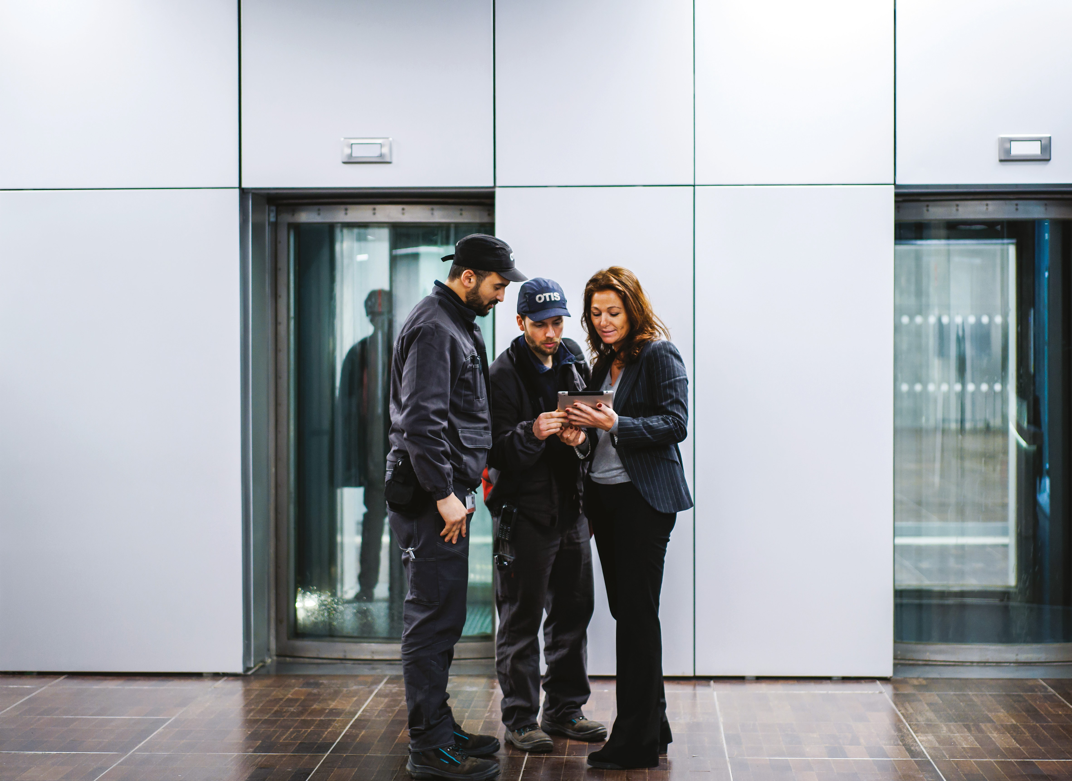
Warranty Manual Contents
Warranty Manual Contents
OTISLINE® Warranty Coverage Elevator Key Switches Special Emergency Service REM eService
01

Slide 3
OTISLINE
SMART TECHNOLOGY
Your Otis mechanic is in constant communication with OTISLINE via smartphone technology. As a result, we can respond to your call quickly.
CONTACT US
Otis eService App
iPhone, Android & Windows
To Download:
OTISLINE®
HOW TO PLACE A SERVICE CALL
Search "Otis eService" in the application marketplace and download accordingly.
OTISLINE EMPLOYEES
Work directly for Otis
Serve as your personal customer advocate Are experts in the elevator industry
Log all calls for our e-Service portal Provide 24 hour support, 365 days a year
By Phone:
English: (800) 233-6847
French: (800) 238-6847
Spanish: (800) 872-6847
OTISLINE™ CUSTOMER CARE CENTER
CONTACTING OTISLINE
Easily contact OTISLINE using the customer portal, mobile app, or by phone.
SERVICE CALL HISTORY
OTISLINE logs all service calls, which will appear in the online Customer portal and recent activity in both the Customer portal and Mobile app. You can refer to these valuable records of activity at any time.
Within minutes, a customer service representative can have a mechanic on the way to your building. Our service professionals provide support 24 hours a day 365 days per year to ensure you receive a prompt, professional response.
Please have your Building ID number ready and be prepared to provide a brief description of the problem.
02

Slide 4
OTISLINE
A QUALITY-DRIVEN, CUSTOMER-FOCUSED CARE CENTER OFFERING EXCEPTIONAL SERVICE
SERVICE TIPS
If the elevator is not working properly, check the items listed below before you contact Otis for service. It could save you the cost of a service call and shorten the time your elevator is out of service.
OTISLINE IN AN EMERGENCY
As part of our service to you as a maintenance customer, your Otis mechanic will program your elevator emergency telephone so it can be used to call OTISLINE automatically in emergency situations, in adherence to ADA guidelines.
Are there any objects lodged in the door sills? Are there smudges on the door detectorlenses? Is the RUN/STOP switch on STOP?
Is the elevator in Independent Service mode?
Is the elevator receiving power?
This is a cost savings to you since no
third-party service provider is necessary. Our professional customer service representatives are trained to respond to both service-related and emergency calls.
Hydraulic elevators:
In cold weather conditions, run the elevator up and down several times to warm the oil for optimal performance.
OTISLINE STATISTICS
Average call wait time: 9 seconds
Average time to restore service: 2.5 hours
If an elevator is operating in an unsafe manner, the car should be taken out of service and should not be serviced by anyone who is not a trained elevator professional.
Annual number of calls:
1.2 million
03

Slide 5
Warranty coverage
Warranty coverage
NEW INSTALLATION DETAILS
Your New Installation Service (NIS) Period Coverage
During this period, an Otis Maintenance Examiner will be assigned to your building and will regularly examine, lubricate, and adjust your equipment.
This will ensure its safety, dependability, and peak performance. The warranty period offers
the following:
Repair and Replacement of Components
With the NIS period, all replacement items, relating to the normal operation of the equipment, including major components, and labor are included. We warrant that only Otis-approved components will be used in carrying out repairs. All repairs will be carried out during Otis Working Hours.
Any minor repairs that are required as a result of normal use will be undertaken at the time maintenance is performed. Major repairs will be planned and carried out by specialist Otis engineers or subcontractors at agreed times.
04

Slide 6
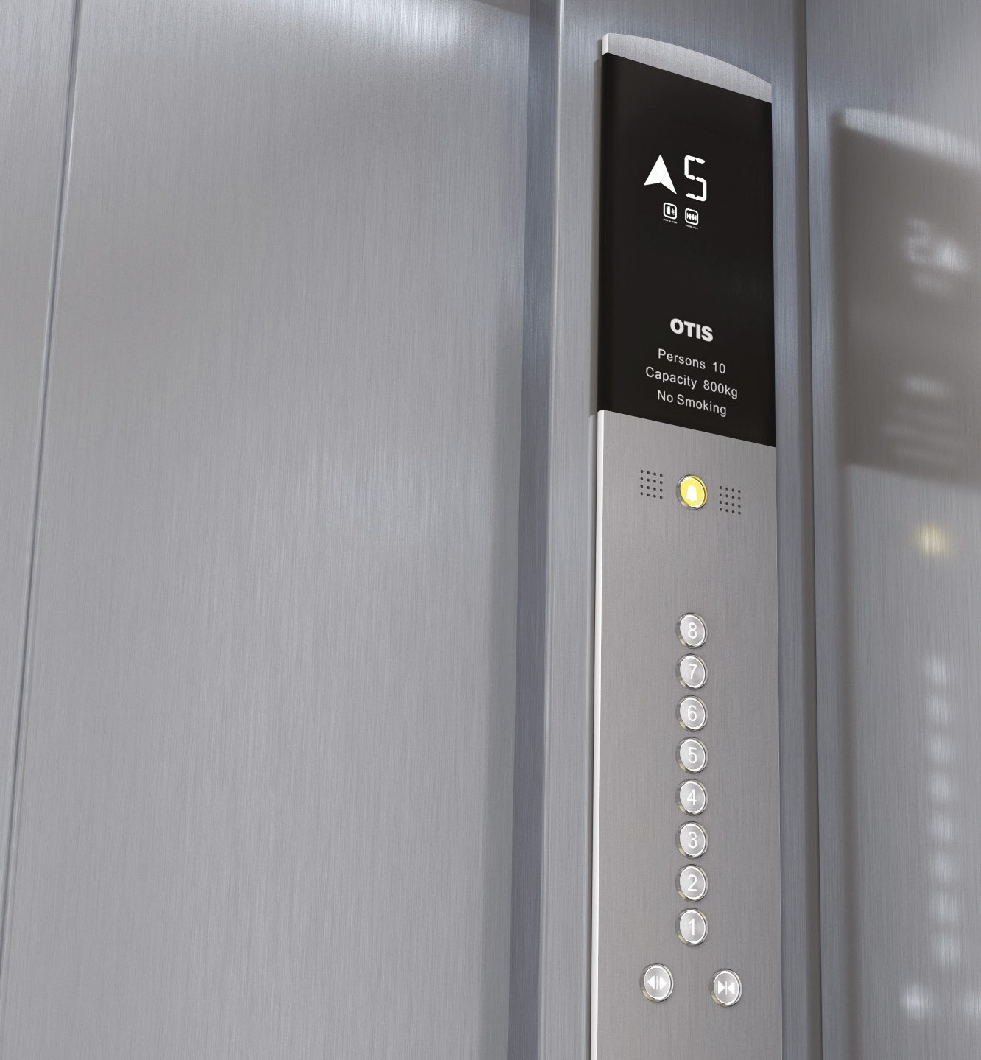
Elevator key switches
Elevator key switches
Hoistway Access
NOT ALL KEY SWITCHES ARE AVAILABLE IN EVERY STATE. THE AVAILABILITY OF KEYS IS DEFINED BY A17.1
Allows the maintenance examiner to inspect the elevator from the car top. This feature should also be used by building personnel to take the elevator out of service for events such as cleaning or when a problem occurs. Use key marked "UTH"
Run/Stop key switch
Turns the elevator off. This function should not be used by building personnel since it will generate a service interruption message if the elevator is on ‘Remote Elevator Monitoring’. Use key marked "UTE"
Cab ventilation fan key switch
Toggles the fan on and off. Key is marked "UTB"
Independent Service key switch
Normally used by building personnel for deliveries when exclusive use of the elevator is needed.
Communication Failure key switch
This feature removes the elevator from normal operation and bypasses all hall calls. To start car, register a call on a car button and hold the ‘door close’ button until the doors are fully closed. Key is marked "UTA"
This feature will silence an alarm that is initiated when the phone line in the elevator is not communicating.
Key is marked "UTB"
SES Fireman’s Recall Operation key switch
This feature is for Fire Department use ONLY. See enclosed Fireman’s Recall instruction page. Key marked "FEOK1" (Or UTF, UTH, BFD1, YALE 3502
depending on jurisdiction)
Cab ceiling light key switch
lf you have a service cabinet in lieu of individual key switches, your service cabinet key may be "UTB"
or same as SES key
Key is marked "UTB"
05

Slide 7
Independent Service Operation
Independent Service Operation
Have you ever begun to load your elevator with materials then turned around to gather more items only to find that the elevator doors closed and now your belongings are traveling without you to another floor?
The Independent Service key switch is for scenarios such as this. Actuation of the Independent Service switch of a particular elevator will remove that car from normal group operation, permitting it to respond only to calls registered on car buttons.
SAMPLE APPLICATIONS:
Hotel event setup/tear down.
Condo/Apartment tenant move-in/out.
School move-in/out: new desks and classroom equipment during the summer months and student housing transitions.
Nursing home where the elevator is used to load multiple carts for daily food services.
Building renovations where the elevator is needed to move materials for various contractors.
06

Slide 8
Independent Service Operation
TO ACTIVATE
ACTION | INSTRUCTIONS
#1 - Initiate Switch | Insert "UTA" key into switch within car (or behind service panel) and turn to "ind".
#2 - To close door | Press and hold "CLOSE" button on car-operating panel; hold until door is fully closed. If you release button before doors are fully closed, they will reopen.
#3 - Select a landing | Select the floor button for the desired landing. The eleva- tor will travel to that floor and doors will automatically open. The elevator will remain at this floor with the doors open indefinitely. To travel to an alternate repeat steps 2 & 3.
#4 – Deactivate Independent Service | Insert "UTA" key and turn key to "group". Remove key.
CAN I USE THE STOP SWITCH?
Yes, however do you want to leave your one and only stop switch key in the hands of various users? They will need the key to constantly turn the car on and off with each load. With Independent Service, you can activate the switch, remove the key and teach the users how to properly operate the elevator in Independent mode.
KEEP A LOG
We recommend that when loaning out the UTA key you keep a log of all users to ensure it is returned.
07

Slide 9
Special Emergency Service
Special Emergency Service
TESTING OF THE FIREFIGHTERS’ SERVICE FEATURE
The elevator code requires that you test the Firefighters’ Service monthly to ensure the proper function of Phase I recall and a minimum one-floor operation on Phase II. You must keep a written record of the test on the premises.*
TO ACTIVATE PHASE I
FIREFIGHTERS’ SERVICE
Your elevator is equipped with a special
fire-emergency operation, which (1) removes the elevator(s) from service in the event of a fire, and (2) allows the operation of elevators by trained emergency crews.
HERE’S HOW FIREFIGHTERS’ SERVICE WORKS:
PHASE I is initiated by smoke detectors located in the elevator lobbies, machine rooms and some hoistways. You can also manually initiate this phase by turning a main lobby key switch to the "ON" position. When Phase I activates, all elevators in the group return
non-stop to the lobby and park with their doors open. This ensures that no one is trapped in the elevator and makes cars available for use by emergency crews, as explained under Phase II.
ACTION | INITIATED BY
Send elevator to another floor | Stand at main floor landing which is the floor indicated with a *. Open elevator, select an alternate floor, exit eleva- tor and stand in main hall while elevator travels to selected floor.
Recall call to main landing (*) | Once elevator arrives at selected floor, insert fire key (FEOK1, UTF, UTH, BFD1, YALE 3502 depending on juris- diction) in red key switch located in the hall fixture and turn to "ON."
Observe | Elevator will buzz and automatically travel down to the main (*) landing and park with the doors open. Enter eleva- tor and ensure that the fire hat is illuminated and red.
*In jurisdictions as applicable
08

Slide 10
Special Emergency Service
TO ACTIVATE PHASE II
ACTION | INSTRUCTIONS
Initiate Phase II | Open Fire Service cabinet with fire key. Insert fire key into switch within car and turn to "on".
To close door | Press and hold "CLOSE" button on car-operating panel; hold until door is fully closed. If you release button before doors are fully closed, they will reopen.
Test Fire Service at one floor | Select a landing to travel to by selecting a floor button. Elevator will travel to that floor.
Test door opening | Once at the landing, the doors will not open, press door open button to ensure doors will open enough to peek at the hall, let go and doors should automatically close.
Return to main landing | With doors closed, select main landing (*) elevator will travel back to main landing.
Open Doors | Open doors by pressing and holding door open button until doors are FULLY open.
Turn off Phase II – In Car | Insert fire key into car fire service key switch and turn to OFF, remove key.
Turn off Phase I – In Hall to be capitalized | Insert fire key into hall fire service key switch and turn key to "BYPASS" and then to the OFF position, This should return the elevator to normal operation and your test is complete. Log test in log book.
Note: If the lobby smoke detector senses a fire at the designated or main floor, the elevator system automatically sends the cars to an alternate floor, where they remain parked with the doors open. If the key switch is turned to the "BYPASS" position, the system will bypass the smoke-detector status. This would be used in the event of a faulty smoke detector. The "OFF" position is the normal position for this switch.
PHASE 2 permits trained emergency crews to operate the elevators. These crews may control elevator functions directly from the car by using a key switch in the
car-operating panel. Emergency crews can hold the car at any selected floor, or return it to a designated floor for use by others.
09

Slide 11
Special Emergency Service
SPECIAL EMERGENCY SERVICE LOG Record of Elevator Fire-Service Test OTIS Emergency # 1-800-233-6847
Building Name | Building ID | _{Machine #} Customer Designation
DATE | INITIAL | REMARKS/NOTES

Slide 12
Emergency Procedures
Emergency Procedures
EMERGENCY REMOVAL OF PASSENGERS FROM ELEVATORS
It is best to contain a "trapped" passenger within the cab until trained personnel can remove them. Door restriction devices prevent the passenger from opening the car door when the car is not at or near floor level; the top emergency exit cannot be opened from within the car, etc. This helps to prevent injuries (or death) which can occur when well-meaning, but untrained people try to extricate themselves, or others, from stalled elevators.
Therefore, we recommend the following procedure in the event of a passenger trapped in an elevator.
Ask the passenger(s) to make sure that the red emergency stop switch is in the "Run" position.
Your elevator equipment has many built-in safety features that reduce the risk of personal injury and property damage in the event of malfunctions or disasters; however, your building staff still plays a vital role in directing occupants to safety, by monitoring equipment, and operating controls that initiate emergency features.
Call Otisline® (see Placing a Service Call). Inform the Customer Service Representative that people are trapped in the elevator. Entrapments receive priority service.
The next few pages describe the following important safety features. Please familiarize yourself with these features.
Give your customer service representative a phone number where you can be reached should they need to contact the building.
Note: This is a potentially hazardous operation and should only be performed by trained personnel. We strongly recommend that neither you nor your building staff attempt to free trapped passengers.
Do not call '911' unless it is an emergency. There have been instances where considerable damage was done to an elevator by non-elevator personnel attempting to remove a passenger from an elevator when the situation was not an emergency.
Fireman's Recall Service
Record of Monthly/Quarterly Testing of Firefighters' Service
Communicate with the passenger, reassure them they are safe as long as they do not panic or try to open the doors, and that there is plenty of air in the car. Stay in communication with them until they are rescued. Communication can be by either the standard communication system to the car, or by locating the elevator in the hoistway and communicating verbally through the doors.
National elevator codes (ASME/ANSI A17.1 and CAN/CSA-B44) require that your hoistway doors be equipped with an "emergency unlocking device," which can be operated with a special key. This key will open the hoistway (outside) doors and permit removal of trapped passengers. The key is included in this binder. This key should only be used by trained individuals.
IN CASE OF FIRE
USE EXIT STAIRS
Ask the passengers to push the door open button, as sometimes the elevator is floor level and the door will open.

Slide 13
Care and Maintenance
Care and Maintenance
CAB ENTRANCES AND FIXTURES ARE FINISHED IN A WIDE VARIETY OF DESIGNS AND MATERIALS
Durability and ease of maintenance, as well as bright, colorful appearance, have guided the development of finishes that will not only stand up under heavy wear inflicted by the riding public, but can also provide the aesthetic people expect.
Passenger elevators in office buildings use the popular plastic laminates for wall paneling, preferably with removable panels that can be easily replaced in case of damage. Materials used in elevator finishes are selected not only for their attractive appearance, but also for easy maintenance. Finishes must receive proper upkeep to retain a quality appearance.
Today’s popular elevator finishes are available in bronze, stainless steel, plastic laminates, vinyl laminated on steel, wood, fabrics, and natural components.
Otis experience in fabricating and maintaining cabs, entrances, and fixtures is summarized in the following recommendations for the care and cleaning of a broad range of materials.
Aesthetic and functional requirements determine cab, entrance, and fixture materials and finishes. For example, service elevators often require stainless steel satin finishes or rigidized and other durable materials.
OTIS FINISHES HAVE BEEN SELECTED TO COMPLEMENT AND ENHANCE EVERY INTERIOR DESIGN SCHEME

Slide 14
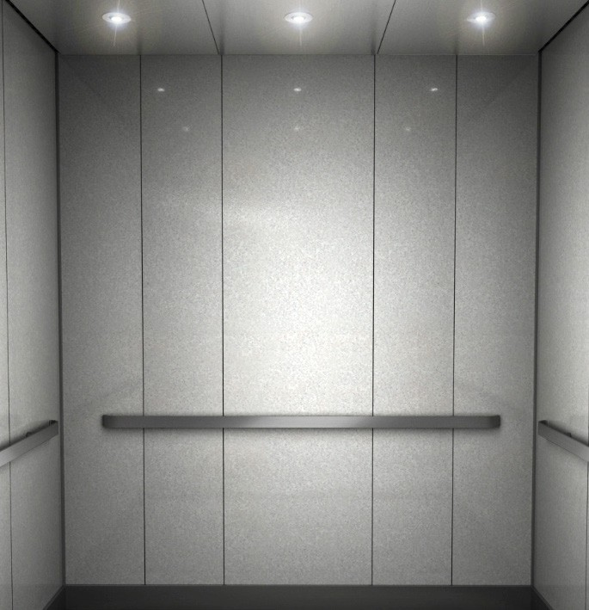
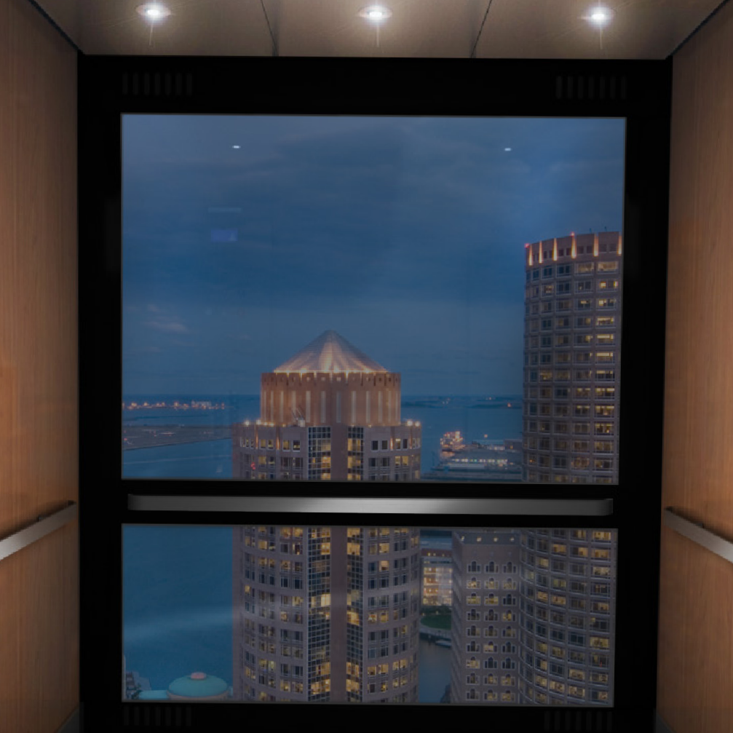
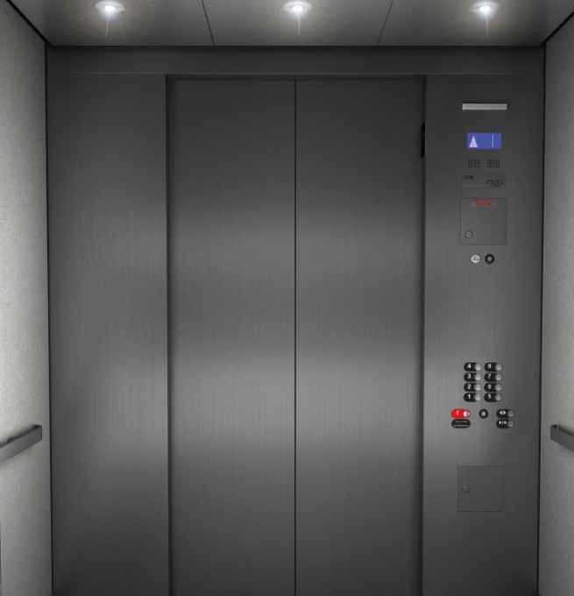
Care and Maintenance
STAINLESS STEEL - MIRROR FINISH
WALL FABRIC
CLEANING
Weekly cleaning with a soft cloth and periodic cleaning with warm water and mild soap are usually sufficient to remove superficial dust and dirt. For stubborn areas, such as finger marks, smudges, etc., the use of a soft bristle brush is recommended.
CLEANING
This highly reflective, contemporary finish should be dusted frequently and washed with mild soap and warm water.
Blemishes caused by oil, tar or grime can be removed with a cleaner by rubbing with a soft cloth to avoid scratches.
Most liquid cleaners and detergents available on the market today, when used according to their labels, have been found to be safe and effective for Otis standard fabric cleaning.
POLISHING
In all cases, however, rinsing with a clean, damp cloth is recommended to ensure no residue remains in the fabric. Since abrasive cleaners could mark or dull fabrics, these should not be used. Use of a flammable cleaner may void the flame tests required for A17.1 code compliance.
This finish should be buffed using a soft, clean cloth with a vertical movement only, not circular.
SCRATCH REMOVAL
Scratches should be removed by professionals only.
CAUTION!
Prior to using any chemical
(e.g., cleaning agent, paint, solvent) review the Material Safety Data Sheet (MSDS) which comes with the product and the product label. Follow these written instructions to avoid all hazards associated with these materials
ON-SITE PROTECTION:
WAXING AND OILING
On non-lacquered, stainless-steel finishes, you can use a light coat of silicone or furniture wax to prevent fingerprints.

Slide 15
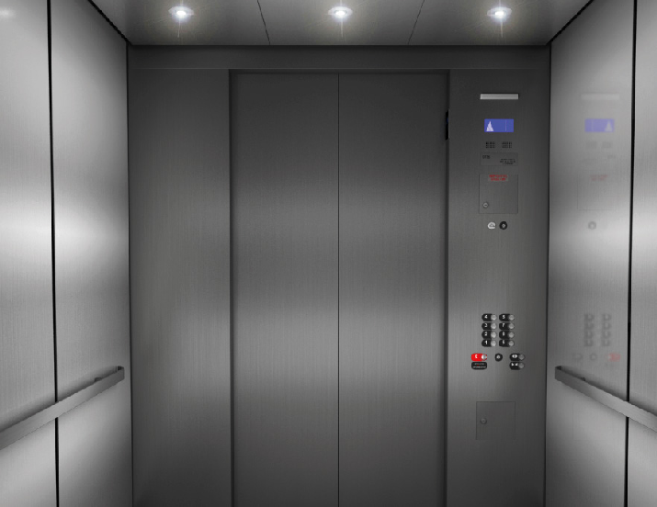
Care and Maintenance
STAINLESS STEEL - MIRROR FINISH
SCRATCH REMOVAL
If normal cleaning does not remove scratches, it may be necessary to resort to sanding. This work is best performed by a metal finishing professional.
PLASTIC LAMINATE
CLEANING
This flexible, attractive finish, available in a variety of colors and simulated wood grains, should be dusted frequently and washed with mild soap and warm water to remove grime.
CLEANING
This soft, contemporary finish should be dusted frequently and washed with mild soap and warm water. Blemishes caused by oil, tar or grime can be removed with Simple Green® or a similar nonabrasive household cleaner by rubbing in the direction of the grain with a soft cloth to avoid scratches.
Sandpaper with grits of #80, #120 and #180 may be used with mineral oil. Start with the finest grit, #180, and proceed to the coarsest required to remove the scratch. Then revert to the finest grit, followed by Scotchbrite® and oil finishing as described above. Always rub with the grain.
Washed surfaces should be rinsed and dried thoroughly. Hard rubbing or abrasive material should not be used.
POLISHING
This grained finish can be polished with a Scotchbrite® type-A pad soaked with lemon or mineral oil and rubbed lightly in the direction of the grain or sanding lines. The surface should be wiped dry using a soft, clean cloth.
BAKED ENAMEL
CLEANING
This rugged, attractive finish is available in a wide variety of colors and should be dusted frequently and washed with mild soap and warm water. Oil, tar and grime can be removed with a cleaner by rubbing with a soft cloth to avoid scratches.
TOUCH UP
Touch-up paint can be obtained by contacting the Otis factory through your account manager. Paint is supplied in half-pint cans for any baked enamel color furnished by Otis. Surfaces should be thoroughly cleaned and dried before applying paint.
ON-SITE PROTECTION: WAXING AND OILING
On non-lacquered stainless steel, a light coat of silicone or furniture wax can be used to prevent fingerprints.

Slide 16
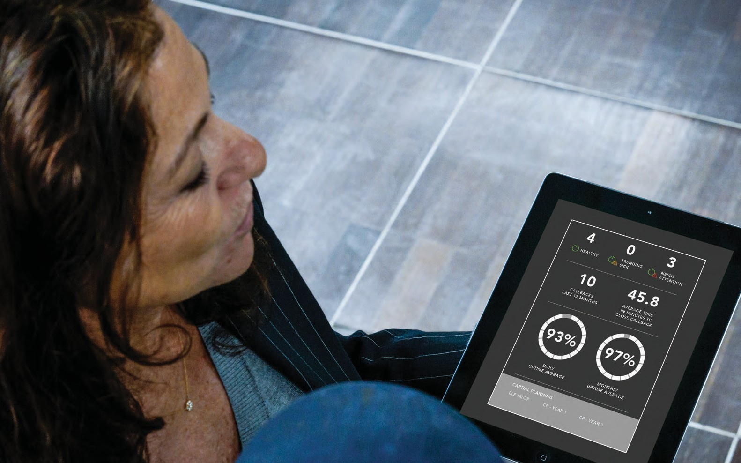
OTIS ONETM
REM
REAL-TIME SMART
SERVICES DESIGNED FOR YOU
EXPERIENCE CONNECTED SERVICE,POWERED BY THE INTERNET OF THINGS
SOFTWARE ENABLE SERVICE
Ready for tomorrow and beyond
TURNING DATA INTO ACTION
Using smart, internet of things (IoT) technology, Otis ONE™ brings you and your passengers the next generation of service. With 24/7 real-time, connected service combined with our foundational historic data your elevator experience will be transformed as you receive new insights. Transparent, proactive, predictive: this is Otis ONE™.
Like technology ecosystems before it, the Otis ONE™ platform is designed to evolve. Powered by the internet of things, machine learning and cloud connectivity, future updates are only a download away. And as we invest in more tools, services and functionality, you can select from a menu of add-ons that make sense for your building and needs
Advanced 24/7 monitoring of critical elevator systems in cab, machine room, hoistway and pit
Cloud-based data analytics
Informed mechanic
Improve elevator performance
View real-time elevator status
Reduce service disruptions with predictive insights
Building manager tracks elevator performance and service delivery in Customer Portal
Drive faster resolution times for a quicker fix with informed mechanics

Slide 17
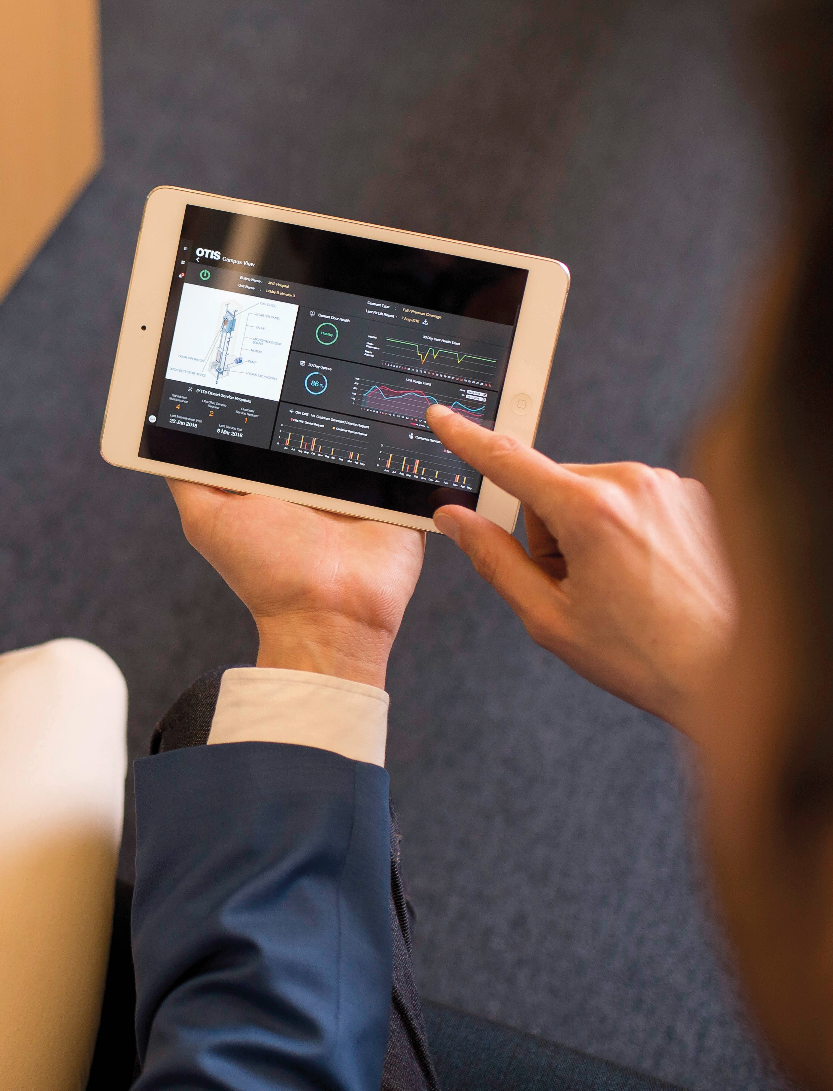
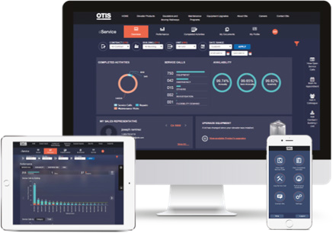
eService
eService
SIMPLIFY DAILY TASKS TO HELP MANAGE YOUR ENTIRE PORTFOLIO
OUR CUSTOMER INTERFACE, REDESIGNED WITH YOUR NEEDS IN MIND
eService is your customer portal, accessible anytime from your computer, tablet or mobile device. Use it to manage your entire elevator, escalator and moving walkway portfolio. It has been designed to simplify your daily tasks.
INFORMED
Get real-time notifications about and access to a complete history of activities of your equipment.
CONVENIENT
Pay bills online and access other personalized data through one simple performance dashboard.
ORGANIZED
Review records and other important service documents.
MOBILE
Time-saving tools designed to keep you up to date on the status of your equipment wherever you are.

Slide 18
eService
WHAT CAN I DO WITH OTIS eSERVICE?
HOW CAN I CONNECT TO eSERVICE?
eService gives you quick and easy access to your recent elevator activity. With eService, you can:
The eService web interface is compatible with computers and tablets. The Otis eService Mobile app is available for Apple, Android and Windows smart phone devices. eService is the most convenient way to manage your portfolio wherever you are, whenever you want.
Stay up-to-date with your elevator service history and performance data
Place a service call
Check and pay your invoices Add a colleague
Book an appointment or contact Otis
HOW DO I GET ACCESS TO eSERVICE?
HOW DO I LEARN MORE OR GET HELP?
If you have not activated your account, go online to http://eService.Otis.us and click on "Sign Up." Fill out and submit the simple request form, and you will receive a confirmation email once your account is activated. you are now ready to discover the benefits of eService.
You can contact your Otis Sales Representative directly or for help: eServiceRequest@otis.com
If you already have an Otis eService account, use your email address and password. If you forget your password, you can click the link to have a new one sent to your email address.

Slide 19
Accessories
EASY-TO-ORDER ACCESSORIES AVAILABLE TO OWNERS
SPARE KEYS
SECURITY SYSTEM
Can’t find your keys or need more? We have replacement keys for firefighters’ service, independent service and priority service.
Restrict unauthorized access to your building elevator. Using a keypad, card reader or proximity detector, Otis security systems help protect tenants from intruders.
ENTRANCE GUARD PROTECTION PADS
Prevent damage to elevator doors, entrances and hoistways while transporting heavy equipment or freight.
ELEVATOR CERTIFICATE FRAMES
EMERGENCY-POWER AND EMERGENCY-RETURN OPERATION
DROP KEY
Mount your certificate of operation in our stainless steel certificate frames. The frames can be easily installed vertically or horizontally in the elevator cab.
Prevent passengers from being trapped during a power outage. Otis
emergency-power systems allow the elevator to operate during a power loss.
A drop key, which opens the hoistway doors, is required to be kept on site if one is not present , a key can be ordered through Otis. The hoistway should be accessed only by elevator or Emergency personnel.
SAFETY SIGNS
Inform the public about safe riding conditions and what to do during emergency situations. We have safety signs in many finishes, including stainless steel and bronze.
ELEVATOR CAB PROTECTIVE PADS
Protect your investment. Purchase protective pads to prevent damage to your elevator-cab interior from wheelchairs, mail carts, stretchers or misuse. The pads can be installed easily using hooks that hang from the wall panels.

Slide 20
Built on a legacy of innovation, Otis
invented the elevator safety brake in
1852, giving rise to the modern city and forever changing how people connect and thrive in a taller, faster, smarter
world.
Today, we’re the world’s leading
elevator and escalator manufacturing, installation and service company. We can be found in many of the world’s
most recognizable buildings, as well as the busiest transportation hubs and
retail centers – we’re everywhere
people are on the move. With a global maintenance portfolio of more than 2 million elevators and escalators,
approximately 2 billion people are moved by our products every day.
Headquartered in Connecticut, USA,
Otis is 68,000 people strong, including
40,000 field professionals, all committed to meeting the diverse needs of our
customers and passengers in more than 200 countries and territories worldwide.
For more information, visit
www.otis.com and follow us on
LinkedIn, Instagram, Facebook and Twitter @OtisElevatorCo.
otis.com
© 2021 Otis Elevator Company
www.otis.com

